Slide 1
MRP: Mini Research Problem
Sentiment Analysis Model Comparison
Name: Mingjie Qiu
ID: 313481
Professor: Dr. Aleksandr Petiushko
Course: MSCS2201-2: Artificial Intelligence
Term: Winter 2026

Slide 2
Overview
Motivation
Sentiment analysis is a fundamental task in Natural Language Processing (NLP) used to automatically determine whether text expresses positive or negative opinions. It has many real-world applications such as:
analyzing customer feedback
monitoring social media sentiment
understanding public opinion on products and services
However, different neural network architectures handle language differently, and their performance can vary significantly.
Main Idea
This project compares three deep learning architectures for sentiment classification on movie reviews:
GRU (Gated Recurrent Unit) – an efficient recurrent neural network
BiLSTM (Bidirectional Long Short-Term Memory) – captures context from both directions
DistilBERT – a transformer-based pretrained language model
All models are trained and evaluated on the IMDb movie review dataset
Final Result:
Transformer models capture contextual meaning better than traditional RNN architectures.
DistilBERT achieves the highest accuracy (85.2%).

Slide 3
Literature review

Slide 4
What is Sentiment Analysis?
Sentiment analysis is a Natural Language Processing (NLP) task that identifies emotional tone in text.
It determines whether text expresses positive, negative, or neutral sentiment.
Common applications include product reviews, social media monitoring, and customer feedback analysis.
Companies use sentiment analysis to automatically understand public opinion.
Machine learning models learn patterns in language that correlate with sentiment.

Slide 5
Recurrent Neural Networks
Early deep learning approaches for Natural Language Processing relied heavily on Recurrent Neural Networks (RNNs) because they are designed to process sequential data such as sentences and documents. Two widely used RNN variants include:
GRU (Gated Recurrent Unit)
Introduced to address the vanishing gradient problem in traditional RNNs.
Uses gating mechanisms to control information flow through the network.
More computationally efficient compared to LSTM.
BiLSTM (Bidirectional Long Short-Term Memory)
Processes sequences in both forward and backward directions.
Captures contextual information from both past and future words in a sentence.
Commonly used in sentiment analysis and other text classification tasks.
However, RNN-based models often struggle with long-range dependencies and slow training due to sequential processing.

Slide 6
Transformer-Based Models
Recent advances in NLP have been driven by the Transformer architecture. Transformers replace recurrence with self-attention mechanisms, allowing models to process entire sentences simultaneously while learning relationships between words.
Key advantages include:
Ability to capture long-distance word relationships
Parallel computation, leading to faster training
Strong performance across many NLP tasks
One widely used transformer model is:
DistilBERT is a compressed version of BERT that maintains high accuracy while reducing computational cost.
Because of these benefits, transformer-based models have become the state-of-the-art approach for sentiment analysis and other NLP tasks.

Slide 7
Dataset

Slide 8
IMDb Movie Review Dataset
Introduction
The IMDb dataset is a widely used benchmark for sentiment classification tasks.
It contains thousands of movie reviews written by real users.
Each review is labeled as either positive or negative sentiment.
Reviews often contain complex sentences, sarcasm, and emotional language.
These characteristics make the dataset realistic and challenging for NLP models.
Feature
Total dataset size: 50,000 reviews.
Training set: 25,000 labeled reviews.
Test set: 25,000 labeled reviews.
Binary classification: Positive vs Negative.
Reviews vary significantly in length and writing style.
Link
IMDB Dataset

Slide 9
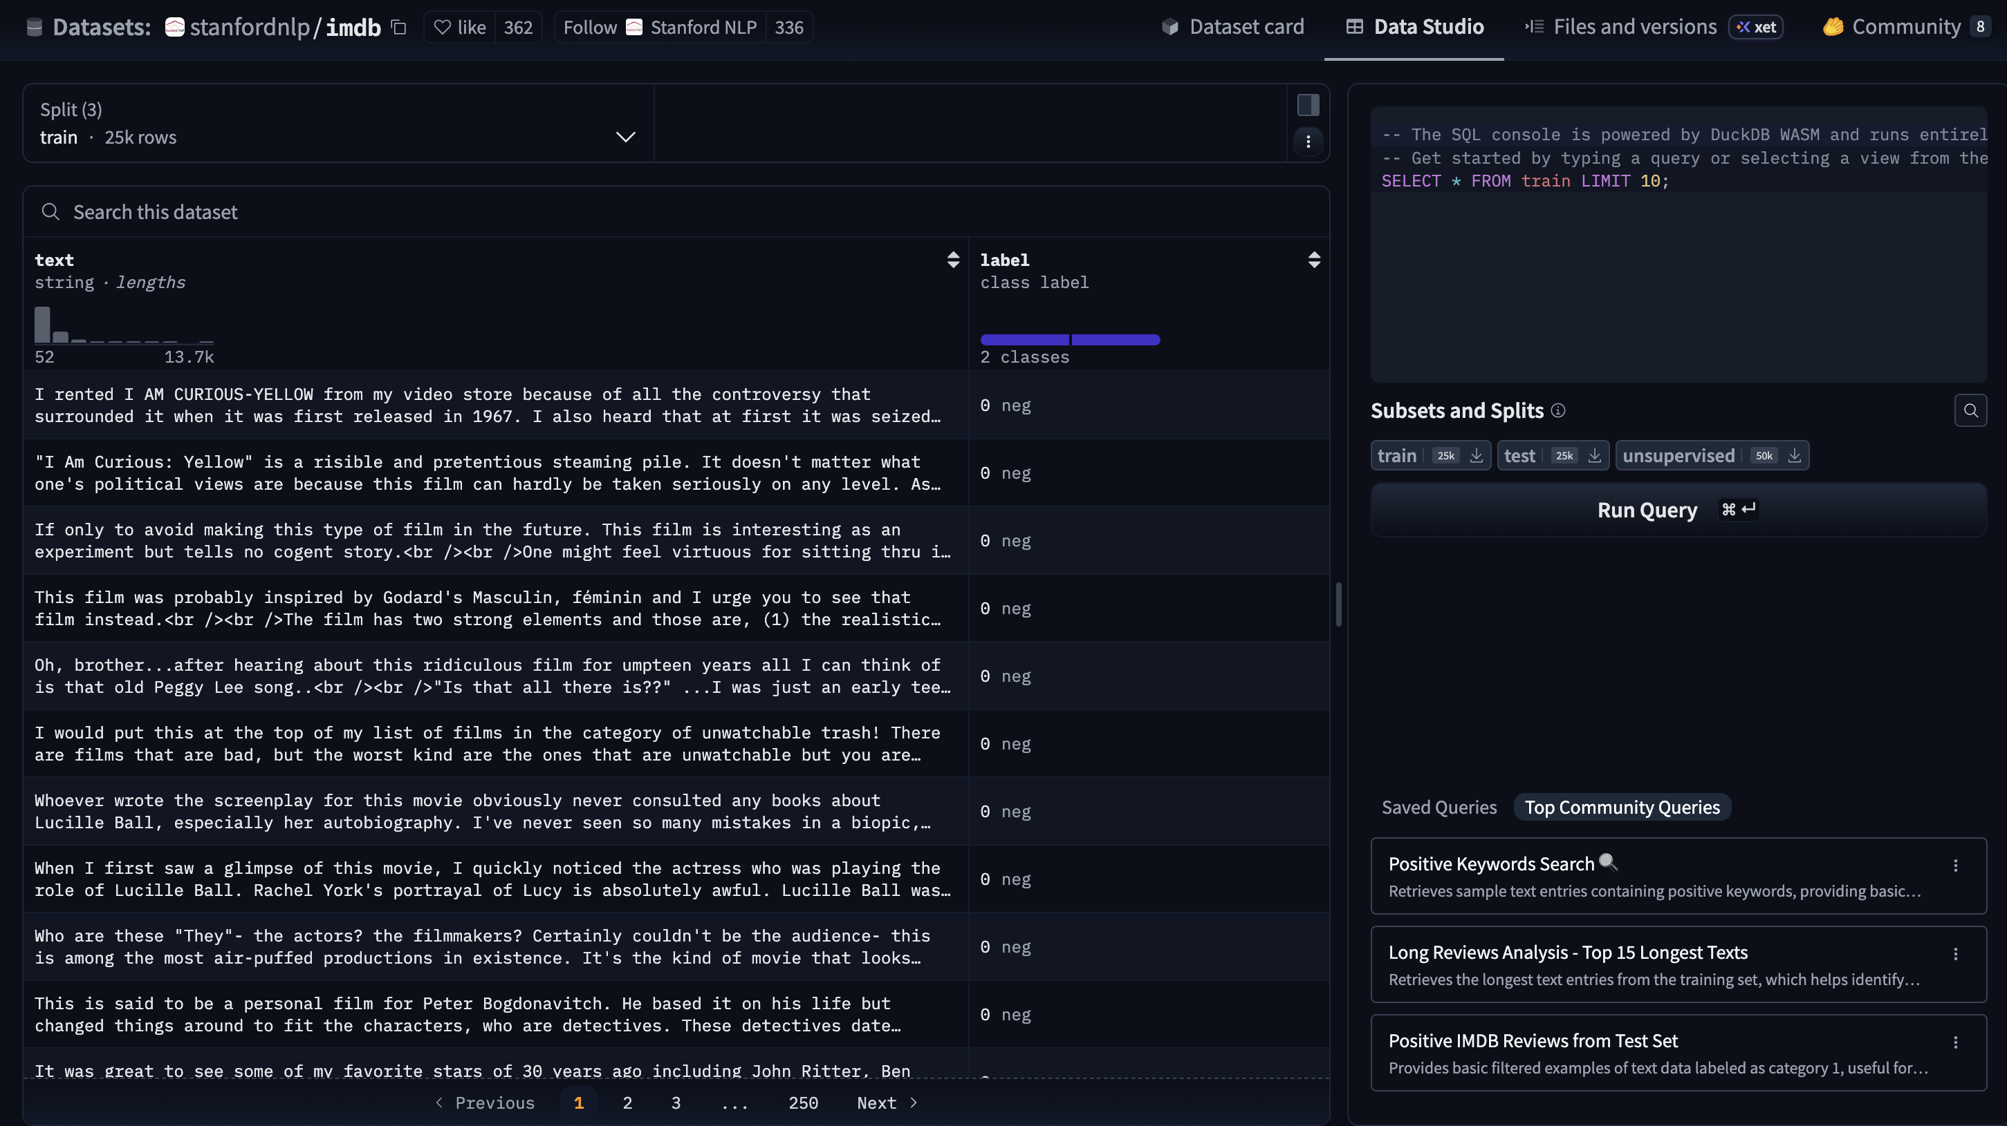

Slide 10
Dataset Sampling for This Project
To reduce training time, a subset of the dataset was used.
Training subset: 5,000 reviews randomly selected.
Testing subset: 1,000 reviews randomly selected.
Random sampling ensures balanced class distribution.
This allows faster experimentation while preserving meaningful evaluation.

Slide 11
Approach / Methodology

Slide 12
Overall Approach
This project evaluates multiple neural network architectures for sentiment classification using the IMDb Movie Review Dataset. The workflow follows these steps:
1. Dataset Loading
Reviews were loaded using the Hugging Face Datasets library.
2. Text Preprocessing
All text is converted to lowercase for consistency.
Words are tokenized by splitting sentences into tokens.
A vocabulary dictionary is built using the most frequent words.
Each word is mapped to an integer index.
Sequences are padded or truncated to fixed length (128 tokens).
3. Model Training
Three architectures were implemented and trained:
GRU (Gated Recurrent Unit)
BiLSTM (Bidirectional LSTM)
DistilBERT Transformer
4. Evaluation
Models evaluated using classification accuracy
Additional metrics recorded:
training time
model parameters
efficiency (accuracy per training second)

Slide 13
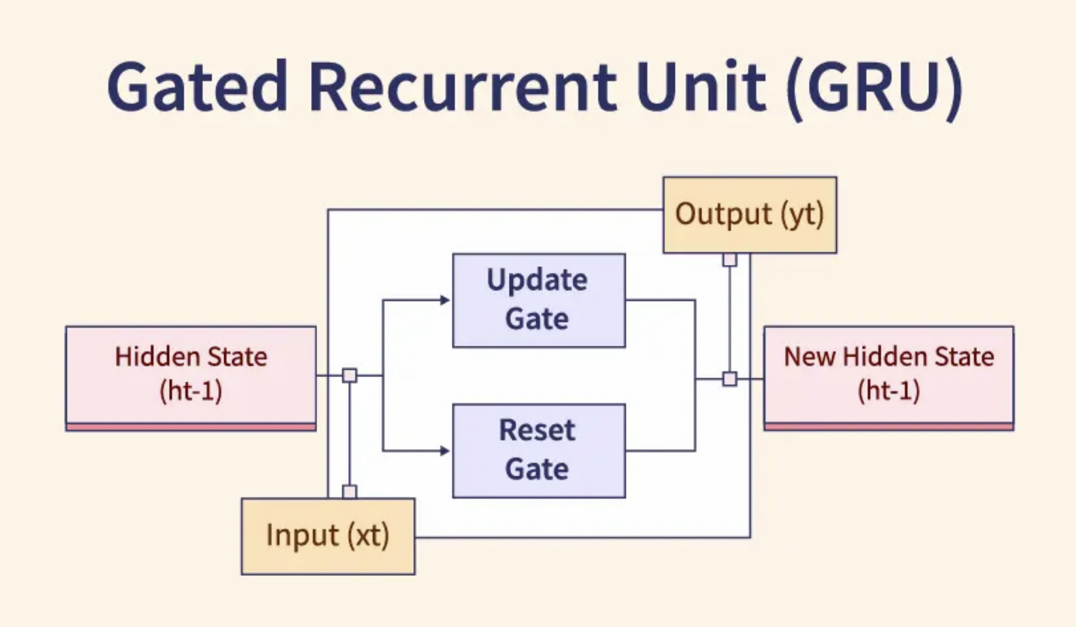
Model 1: GRU (Gated Recurrent Unit)
Architecture:
Bidirectional GRU with 2 layers
Embedding dimension: 300
Hidden dimension: 600
Fully connected layers: 256 → 2 (binary classification)
Dropout: 0.5, ReLU activation
Training Details:
Optimizer: AdamW with weight decay 0.01
Learning rate scheduler: CosineAnnealingLR
Batch size: 32, Epochs: 10
Key Idea: Captures sequential dependencies and contextual information efficiently, faster than BiLSTM.

Slide 14
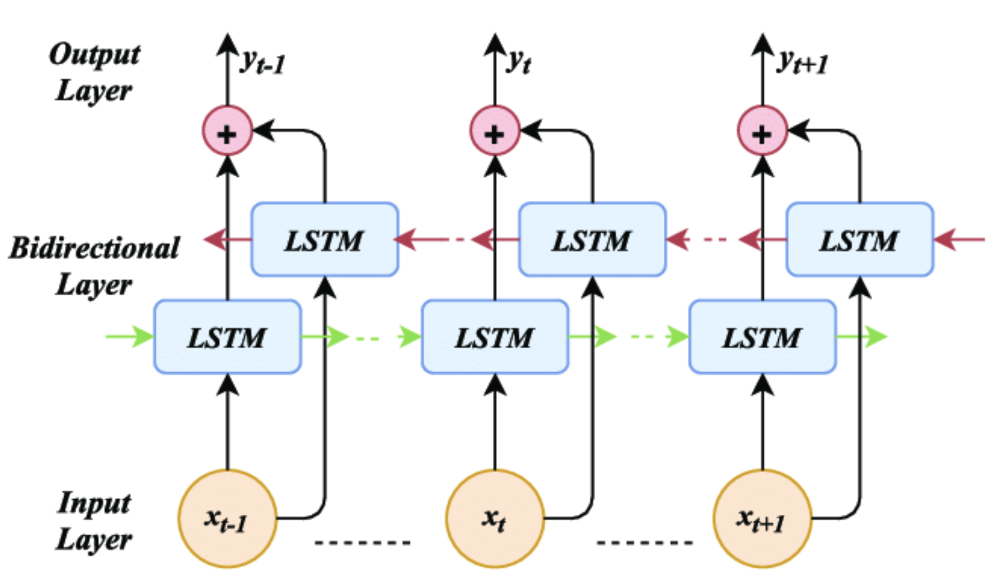
Model 2: BiLSTM (Bidirectional Long Short-Term Memory)
Architecture:
Bidirectional LSTM with 2 layers
Embedding dimension: 300
Hidden dimension: 600
Fully connected layers: 256 → 2
Dropout: 0.5, ReLU activation
Training Details:
Optimizer: AdamW with weight decay 0.01
Learning rate scheduler: CosineAnnealingLR
Batch size: 32, Epochs: 10
Key Idea: Captures longer dependencies in sequences, but more parameters and slower training than GRU.

Slide 15
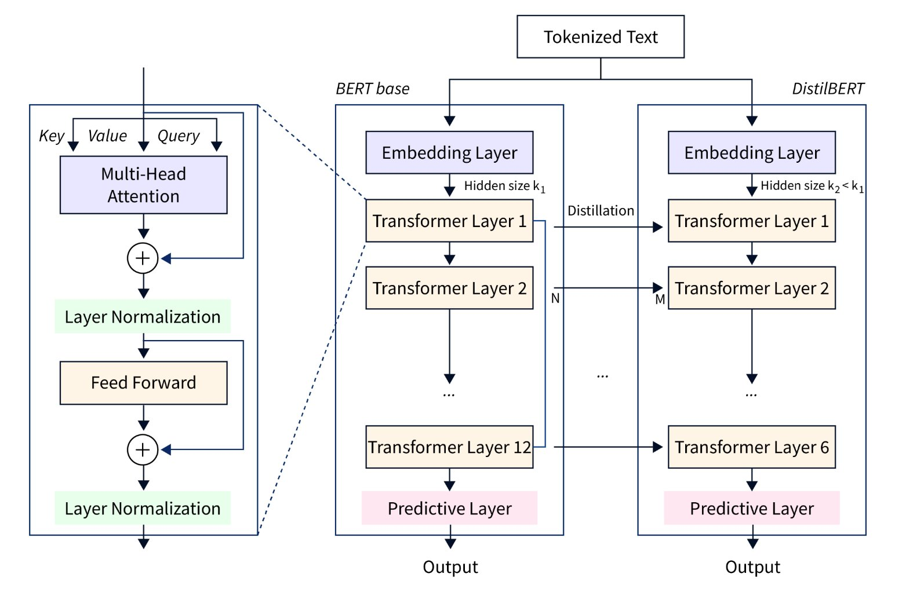
Model 3: DistilBERT
Architecture:
Pretrained DistilBERT (6-layer transformer)
Hidden size: 768
Output layer: 2 classes
Tokenizer: distilbert-base-uncased
Training Details:
Trainer API from Hugging Face
Batch size: 8, Epochs: 10
Evaluation strategy: per epoch
Key Idea: Pretrained transformer captures deep contextual understanding, highest accuracy despite longer training and model size.

Slide 16
Code Repository
https://github.com/MingjieQiu/MRP
Video Demonstration
Mini ResearchProblem​ - Sentiment Analysis Model Comparison​ - GRU/BiLSTM/DistilBERT

Slide 17
Results

Slide 18
Training accuracy / epoch
Epoch | GRU | BiLSTM | DistilBERT
1 | 0.5440 | 0.5474 | 0.8460
2 | 0.6932 | 0.5324 | 0.8370
3 | 0.8228 | 0.5756 | 0.8440
4 | 0.9276 | 0.6542 | 0.8480
5 | 0.9818 | 0.7702 | 0.8440
6 | 0.9958 | 0.8760 | 0.8470
7 | 0.9996 | 0.9408 | 0.8550
8 | 0.9998 | 0.9730 | 0.8520

Slide 19
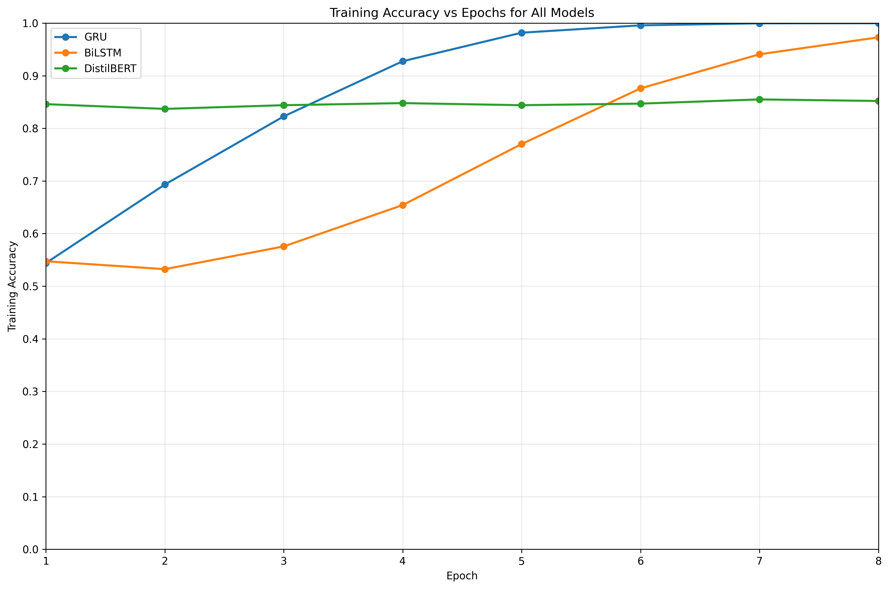
Training Accuracy Visualization

Slide 20
Testing Results
Model | Accuracy | Training Time | Parameters
GRU | 72.6 % | 971.38 sec | 13.04 M
BiLSTM | 66.2 % | 1216.81 sec | 16.28 M
DistilBERT | 85.2 % | 1434.48 sec | 67.95 M

Slide 21
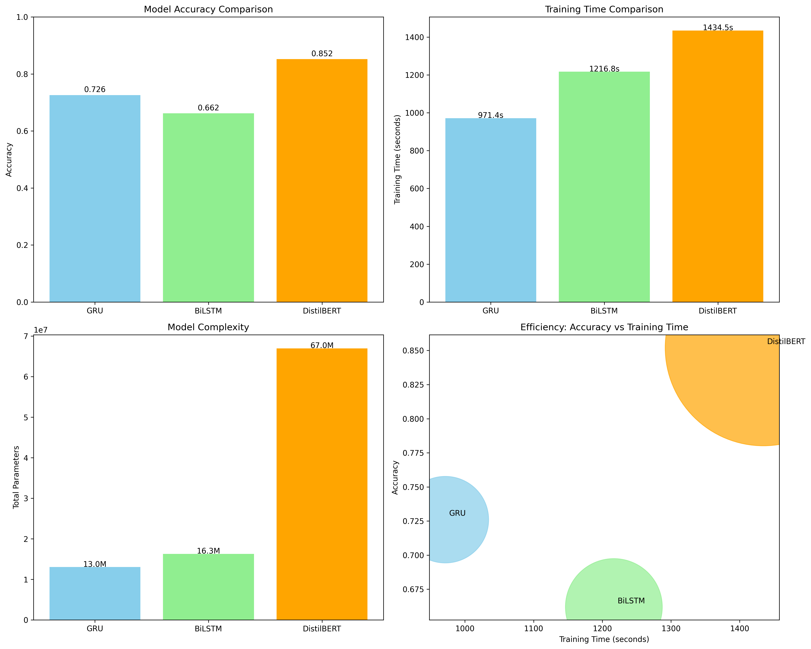
Testing Results Visualization

Slide 22
Comparative Analysis
Training Convergence Behavior
GRU
Demonstrated the fastest convergence
Training accuracy increased rapidly from 54.4% → 99.98% by epoch 8
Indicates strong capacity to memorize training data.
BiLSTM
Slower and more gradual convergence
Training accuracy improved from 54.7% → 97.3% by epoch 8
Learning process was more stable but less efficient.
DistilBERT
Achieved high accuracy from the first epoch (84.6%)
Only minor improvements across epochs
Shows effectiveness of pretrained language representations.
DistilBERT achieved the highest test accuracy
GRU performed moderately well with significantly fewer parameters
BiLSTM showed the lowest performance despite larger model size than GRU

Slide 23
Comparative Analysis
Model Efficiency Trade-offs
DistilBERT
Best predictive performance
Highest computational cost
Largest parameter size
GRU
Best efficiency balance
Faster training and smaller model
Suitable for limited computational resources
BiLSTM
Higher complexity than GRU but lower accuracy
Indicates inefficient parameter usage for this dataset.

Slide 24
Key Findings & Insights
1. Transformer Models Provide Superior Accuracy
DistilBERT achieved 85.2% test accuracy, outperforming both RNN models.
The self-attention mechanism enables better contextual understanding of text.
2. Evidence of Overfitting in RNN Models
GRU and BiLSTM training accuracies approached ~100%.
However, test accuracies remained significantly lower:
GRU: 72.6%
BiLSTM: 66.2%
This suggests overfitting to the training data.
3. Pretrained Models Improve Generalization
DistilBERT showed smaller gap between training and test performance.
Pretraining on large corpora provides better language understanding.

Slide 25
Key Findings & Insights
4. Model Complexity vs Performance
DistilBERT has ~67M parameters, far larger than RNN models.
However, higher parameter count alone does not guarantee performance, as shown by BiLSTM vs GRU.
5. Practical Deployment Considerations
High accuracy applications: DistilBERT is the best choice.
Resource-limited environments: GRU offers the best trade-off between speed and performance.
BiLSTM models may require stronger regularization or larger datasets to compete.

Slide 26
References
Vaswani, A., Shazeer, N., Parmar, N., Uszkoreit, J., Jones, L., Gomez, A. N., Kaiser, Ł., & Polosukhin, I., “Attention Is All You Need,” NeurIPS, 2017.
Devlin, J., Chang, M., Lee, K., & Toutanova, K., “BERT: Pre-training of Deep Bidirectional Transformers for Language Understanding,” NAACL-HLT, 2019.
Sanh, V., Debut, L., Chaumond, J., & Wolf, T., “DistilBERT, a distilled version of BERT: smaller, faster, cheaper and lighter,” arXiv:1910.01108, 2019.
Cho, K., van Merriënboer, B., Gulcehre, C., et al., “Learning Phrase Representations using RNN Encoder–Decoder for Statistical Machine Translation,” EMNLP, 2014.
Hochreiter, S., & Schmidhuber, J., “Long Short-Term Memory,” Neural Computation, vol. 9, no. 8, pp. 1735–1780, 1997.

Slide 27
Thank You

